Slide 1
Eddy WD1
Cheap DIY smart tap controller for purified water

Slide 2
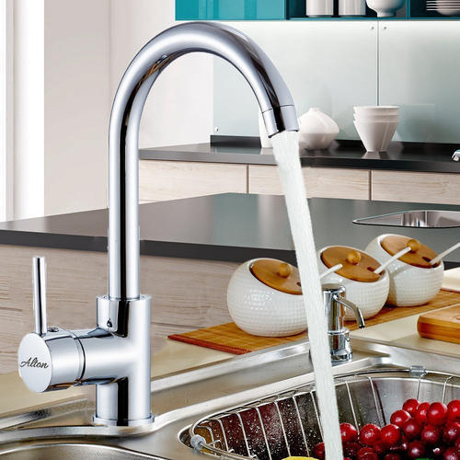
Eddy WD1 - Abstract
One-way valve (optional)
Water filter
Eddy WD1
Bistable or solenoid valve
Flow sensor

